Slide 1

SMART TEXT EDITOR
FOR SIGN LANGUAGE USERS USING COMPUTER VISION
Submitted by:
SUVRANEEL DAS (Roll No.-PG/02/MCA/2022/022)
SURAJ DAS (Roll No. – PG/02/MCA/2022/018)
Under the Guidance of
MR. SAYANTAN SINGHA ROY
(Assistant Professor , Adamas University)

Slide 2
Table of contents
01
07
02
08
03
09
04
10
05
11
06
12
Introduction
Workflow Chart
Objective
Architecture of Dataset Creation
Motivation
Results & Output
System Architecture
Future Work
Methodology
Conclusion
Sign Language Gesture
Thank You

Slide 3
Introduction
The project combines Sign Language Recognition (SLR) technology with a Smart Text Editor for inclusive communication.
The platform facilitates seamless interaction between sign language users and non-sign language speakers.
Advanced computer vision techniques are used for real-time detection and interpretation of sign language gestures.
Deep learning models and image processing capture the nuanced movements and expressions of sign language users' hands.
The system translates these gestures into corresponding text, enabling effective comprehension and response for non-sign language speakers.

Slide 4
Objective
Transform Sign Language into Text for deaf and hard-of-hearing individuals.
Bridge the gap in understanding sign language that has posed difficulties in communication.
Utilize deep learning algorithms to train the model.
Collect and process frames from gestures captured by the camera for training.
Enable real-time prediction.
Translation of gestures into text.
Develop a model capable of identifying symbolic expressions through images.
Test the developed model in real-world scenarios to ensure its effectiveness and practical application in diverse communication settings.

Slide 5
Motivation
Sign language is one of the fastest growing languages of study in the united states. Over 1,000,000 deaf and hearing people use it.
It is the third most common language used in the united states behind English and Spanish.
Learning sign language introduces you to the deaf, dumb & hard-of-hearing community and its rich cultural experiences.
It can open up many opportunities for the deaf, dumb & hard-of-hearing people.
It helps many hearing parents learn to communicate with their deaf child and vice versa.
It can help people with limited verbal skills develop their communication skills.
It also allows to have private discussions in public places.

Slide 6
System Architecture
Smart Text Editor Interface: Tkinter-based, user-friendly interface with interactive text editor.
Camera Integration: Captures live video feed for gesture recognition.
Computer Vision: Utilizes OpenCV and CVZone (MediaPipe) for hand detection, tracking, and feature extraction.
Gesture Recognition: Trained deep learning model classifies sign language gestures.
Real-Time Conversion: Dynamically convert gestures into text.
Deep Learning Framework: TensorFlow Keras for model training.

Slide 7
Technology Used
COMPUTER VISION
NATURAL LANGUAGE PROCESSING
DEEP LEARNING
KERAS
TENSORFLOW
PYTHON LIBRARIES
TKINTER
OPENCV
CVZONE
MEDIAPIPE
PYPERCLIP
PILLOW
NUMPY

Slide 8
Methodology
Literature review and framework establishment
Integration of google’s mediapipe library
Video frame processing
Dataset creation
Model training and evaluation
Prediction of characters
Text editor creation with tkinter
Real time integration
Refinement of code
Continuous improvement

Slide 9
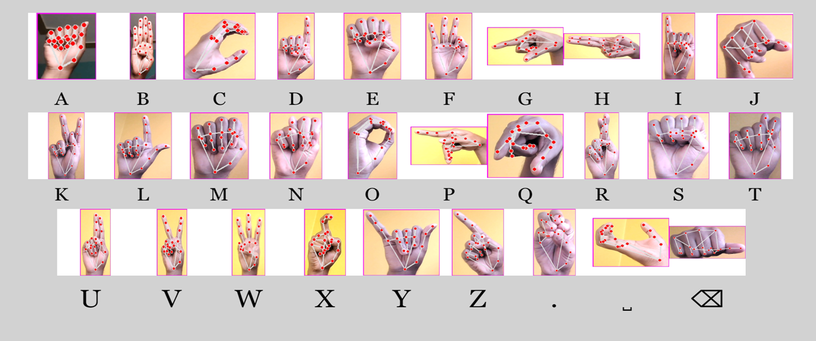
Sign Language Gestures
For this project, we have created our own datasets with the help of american sign language and added some more images as shown in above figure.

Slide 10
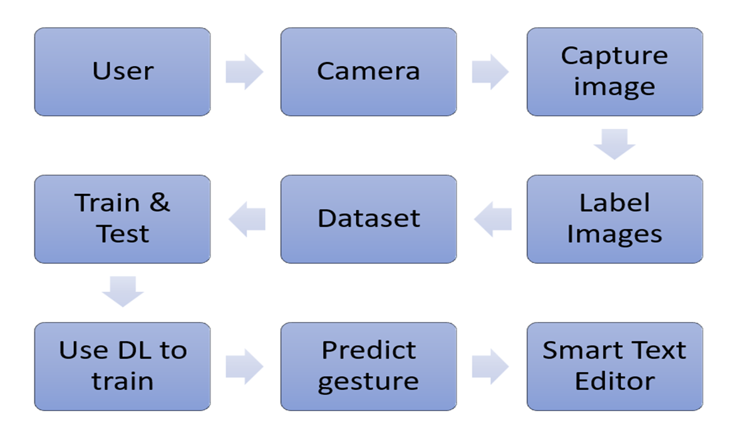
Work Flow Chart

Slide 11
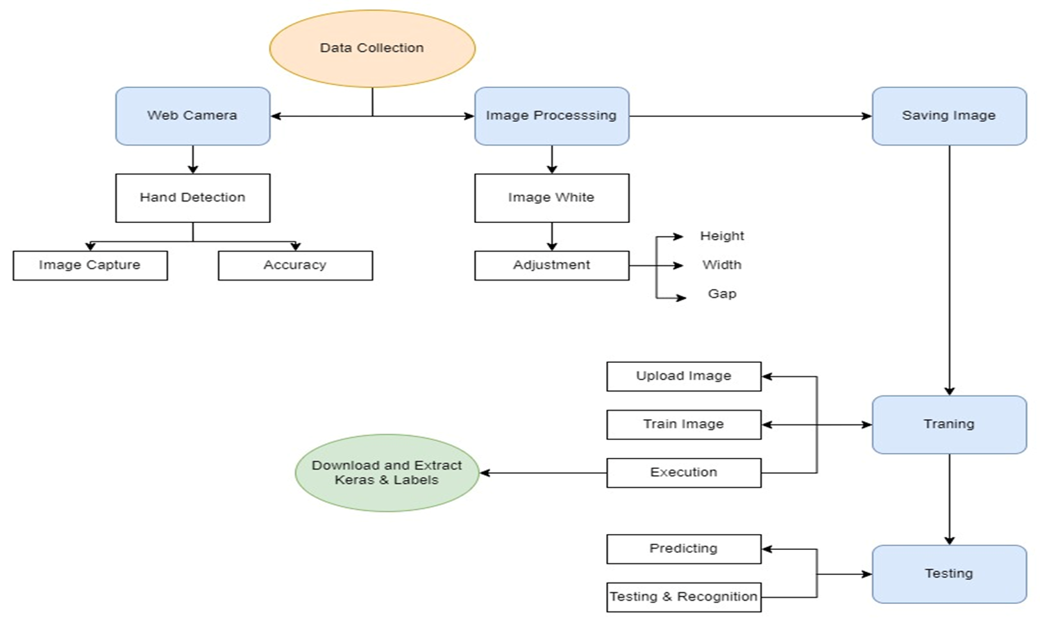
Architecture of Dataset Creation

Slide 12
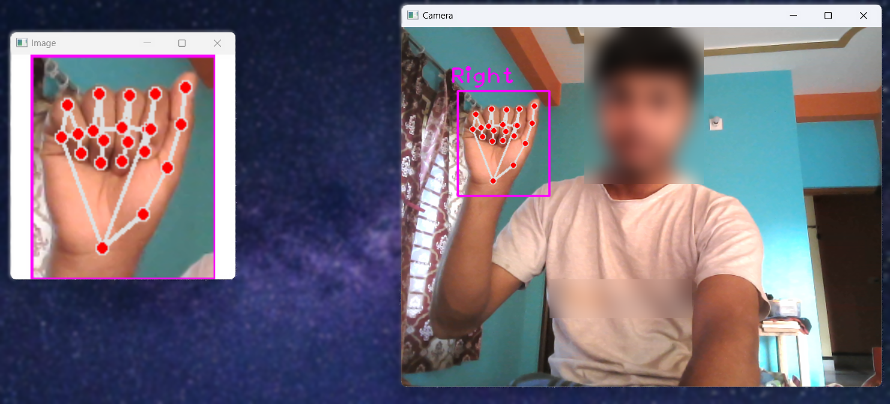
A image of making dataset using OpenCV and Mediapipe library.

Slide 13
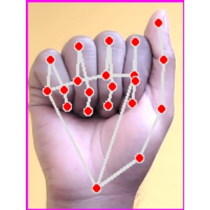
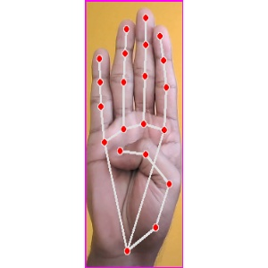
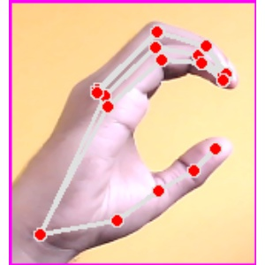
Captured images via OpenCV with highlighted key points for predictive modeling.

Slide 14
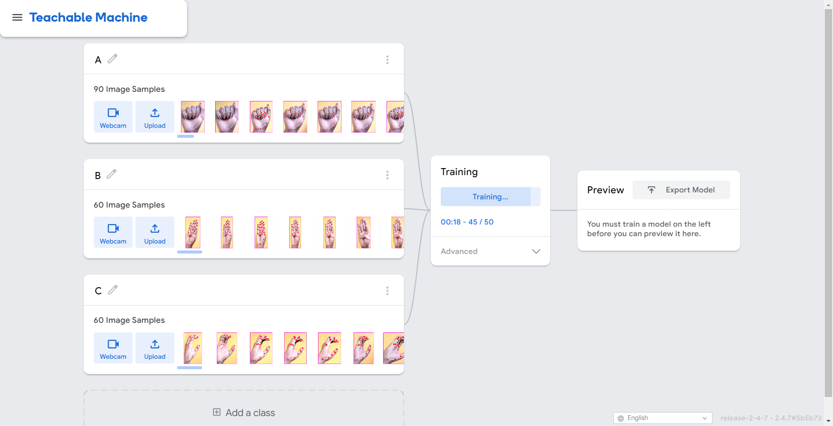
Training datasets with the help of Teachable Machine to build our model.

Slide 15
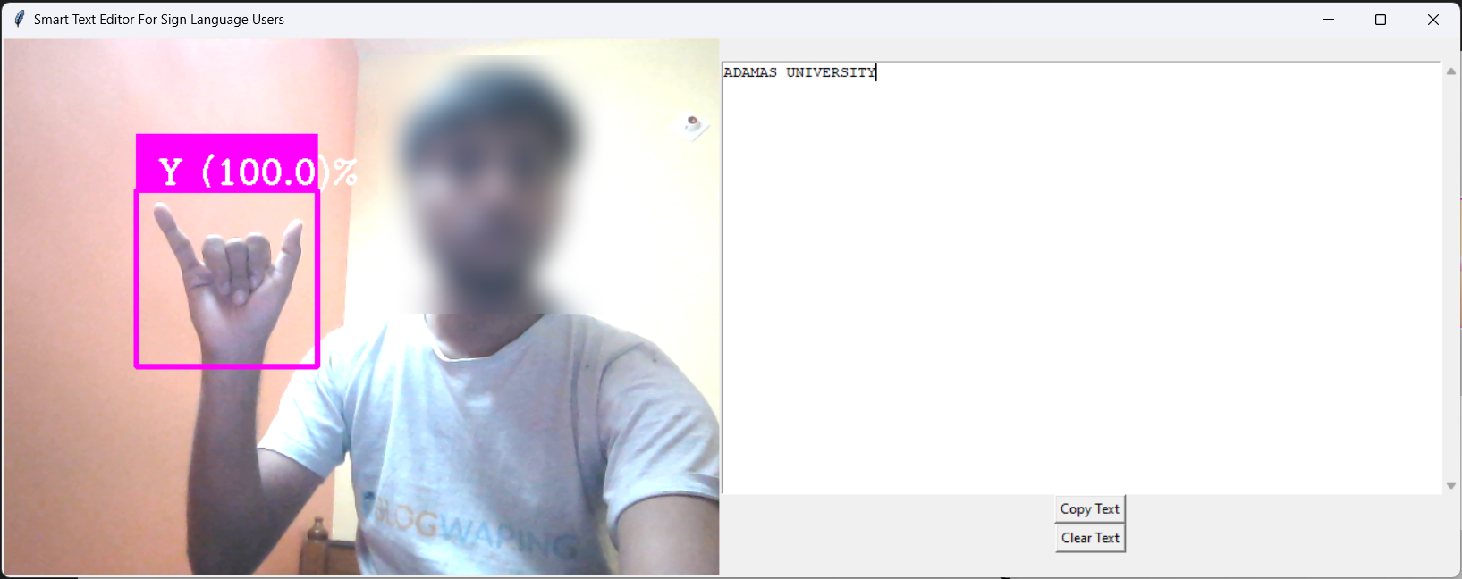
Results & Output
With the GUI toolkit Tkinter, the output of the project looks this.

Slide 16
Confidence Rate of each alphabet
A | B | C | D | E | F | G | H | I | J
85.24% | 94.69% | 93.34% | 96.71% | 90.7% | 87.23% | 84.66% | 89.9% | 96.21% | 78,97%
K | L | M | N | O | P | Q | R | S | T
82.99% | 96.77% | 86% | 73% | 95.2% | 86.88% | 81% | 85.66% | 93.8% | 87.48%
U | V | W | X | Y | Z | . | _ | /
94.75% | 97.54% | 99.76% | 95.5% | 98% | 97.34% | 88.6% | 89.09% | 96.76%

Slide 17
Future Work
Integration with wearable devices
Autocorrection feature
Multilingual support
Offline mode
Compatibility with other communication devices
Text to speech feature
Voice recognition technology

Slide 18
Conclusion
The sign language detection system aims to enhance communication for deaf and hard-of-hearing individuals through hand gestures.
A limitation is identified: not everyone is familiar with sign languages, hindering communication.
To address this, we propose utilizing Automated Sign Language Recognition systems.
These systems will convert sign language motions into commonly spoken languages.
The goal is to make communication more accessible for a broader audience.

Slide 19
Thank You

